Slide 1





Beyond MCP Servers: Why Network Automation Agents Need Knowledge Graphs
Shereen Bellamy
Senior Developer Advocate – AI , Security, Quantum
coffeeAGNTCY maintainer
Github, github.com/shereenb
January 31, 2026

Slide 2
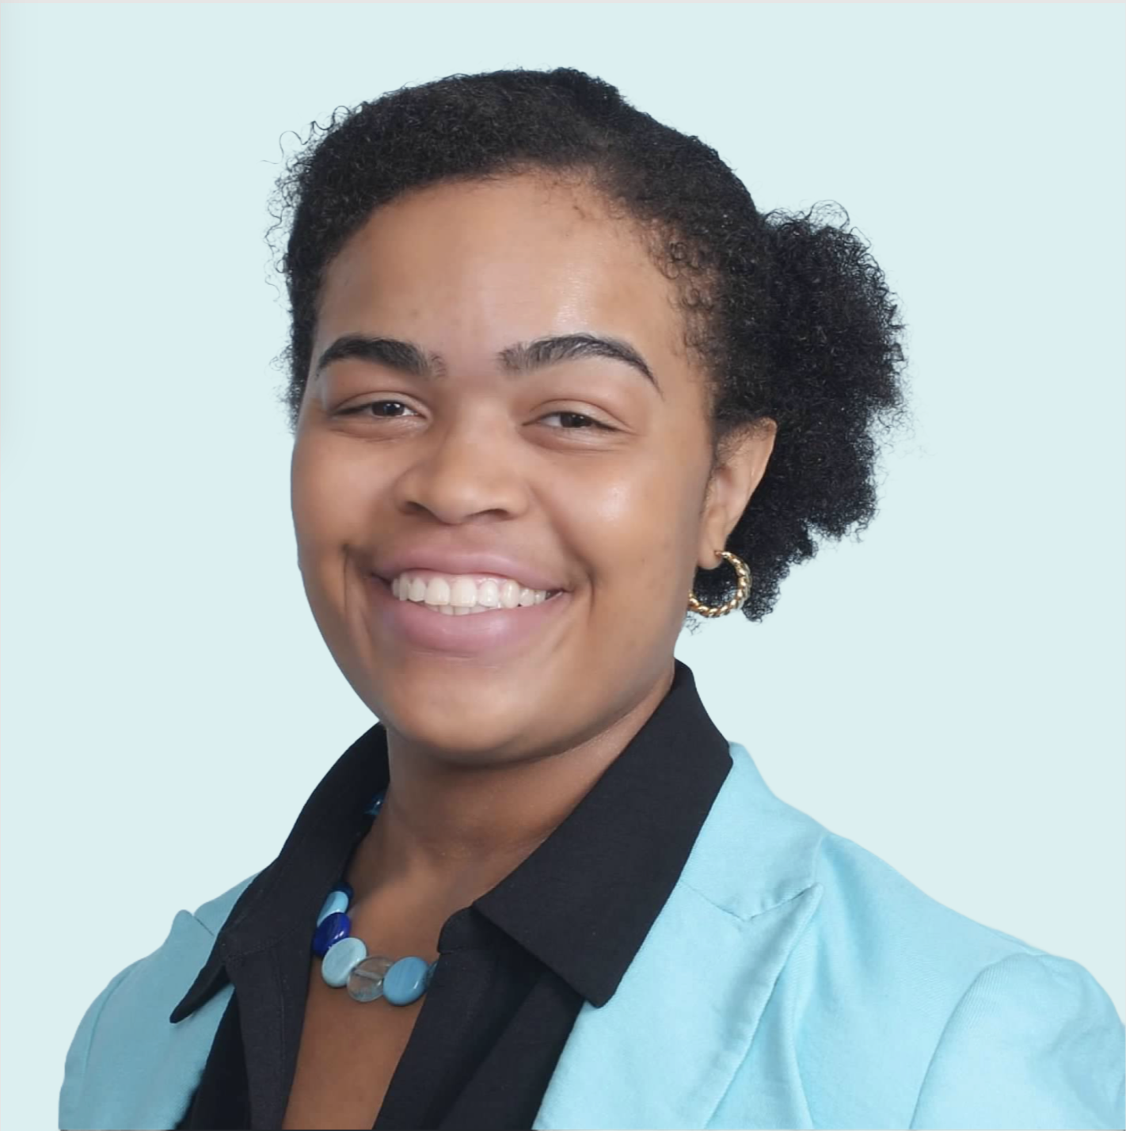
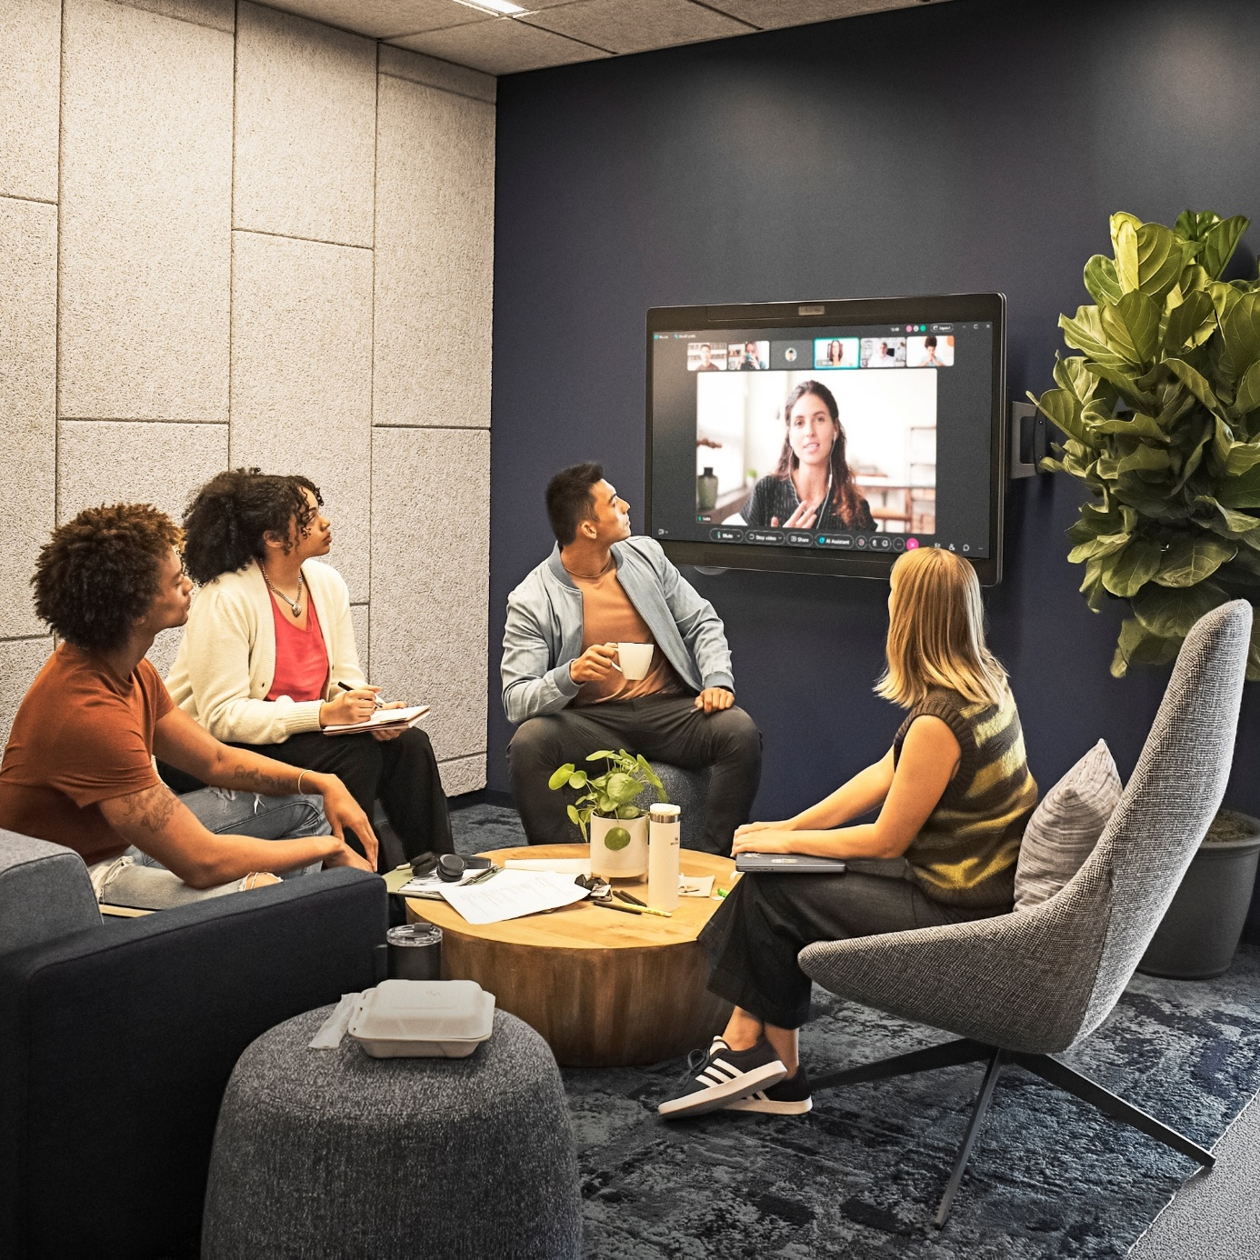
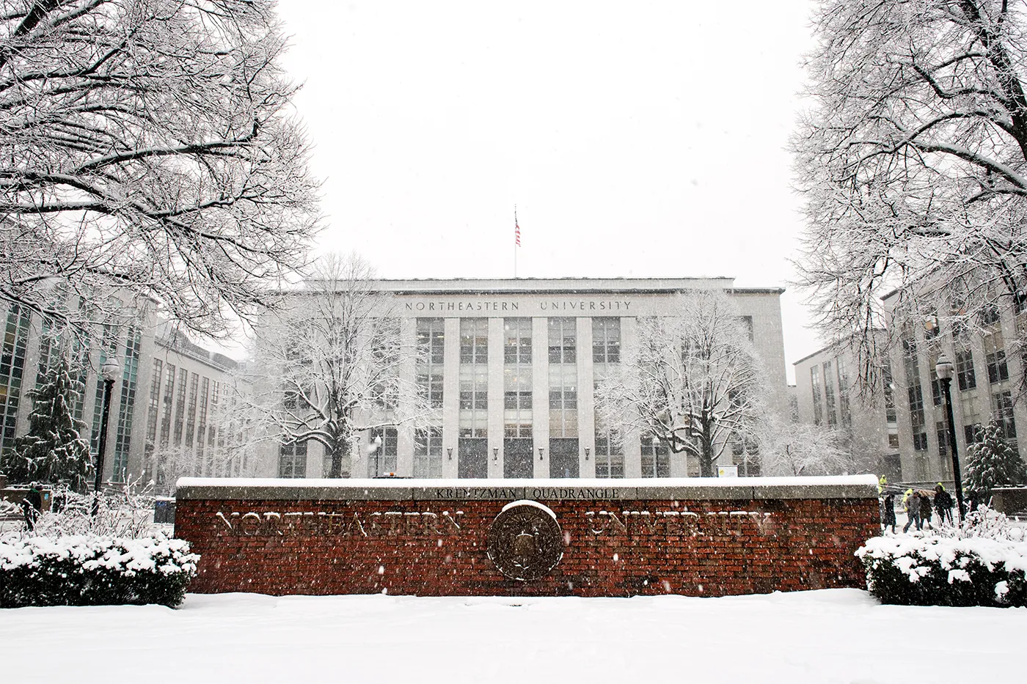
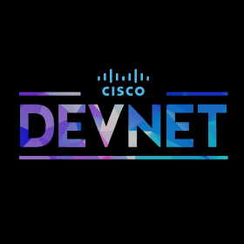
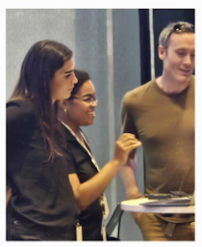

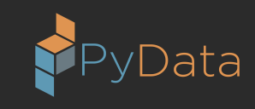
About Me

Slide 3
Agenda
01
The Year of MCP and AGNTCY
02
The Issue with coffeeAGNTCY V1
03
The Power of Graphs!
04
How to Build On This

Slide 4
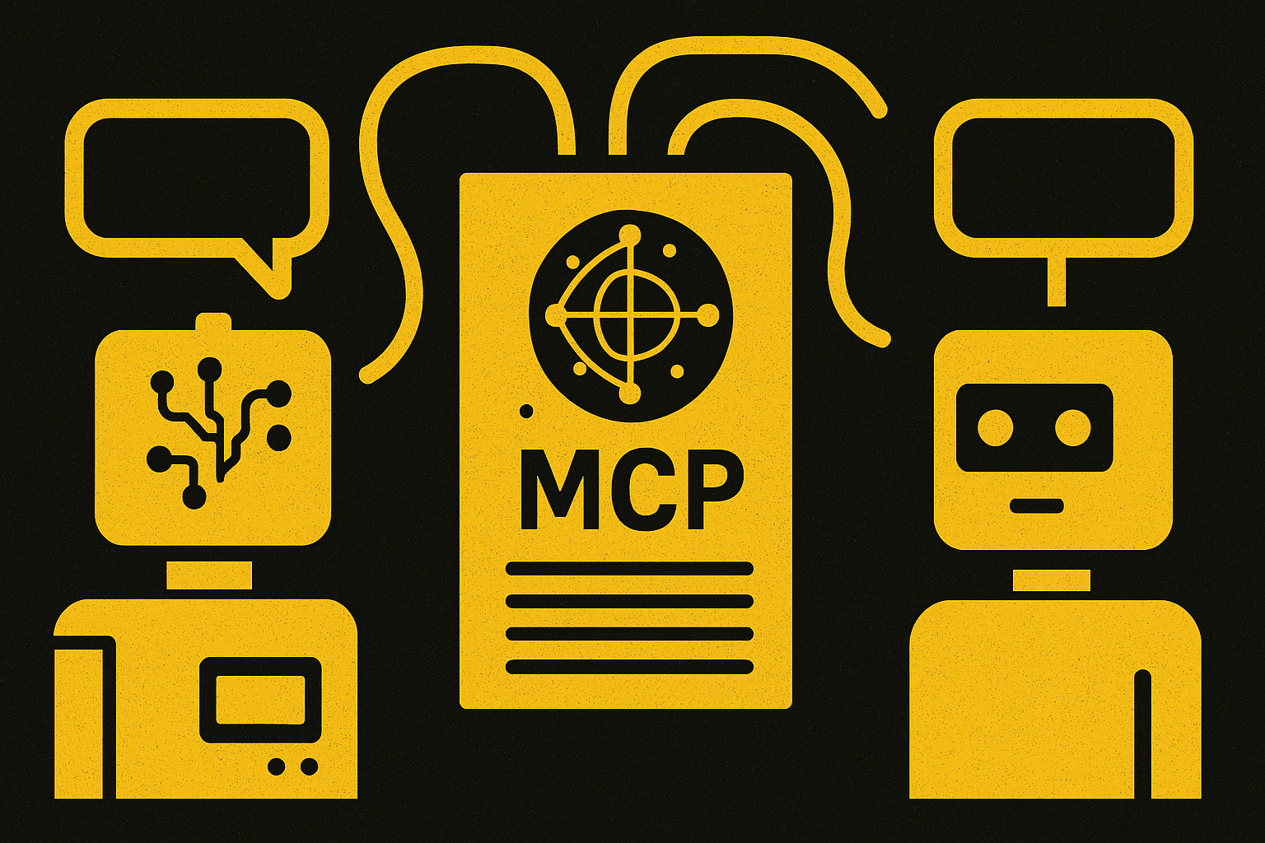
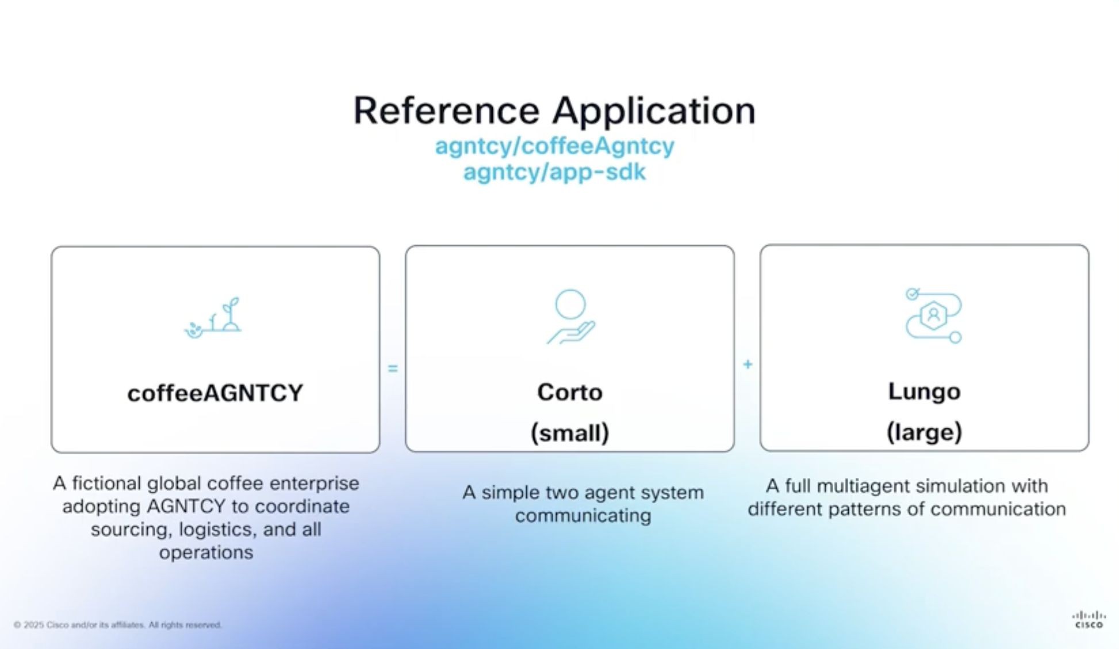

The Year of MCP - 2025
© 2025 Cisco and/or its affiliates. All rights reserved.

Slide 5

The Year of
© 2025 Cisco and/or its affiliates. All rights reserved.

Slide 6
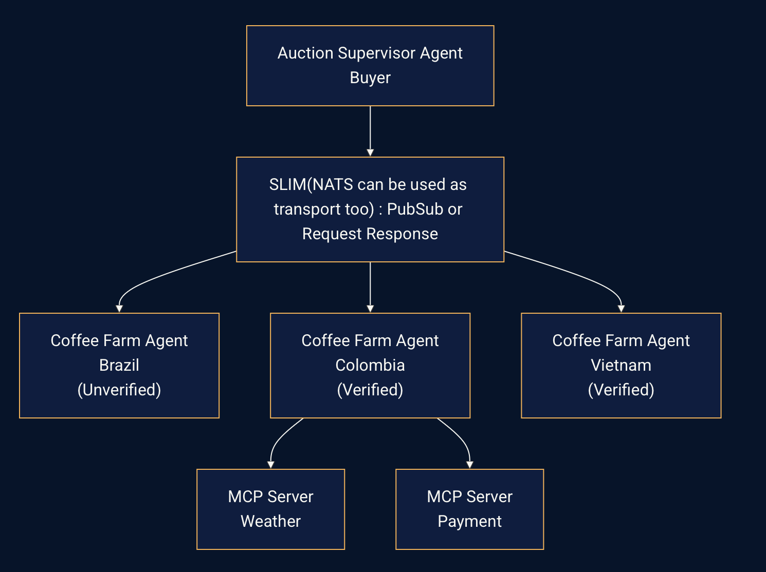
CoffeeAGNTCY (lungo)
The Year of MCP
How do agents communicate?
*Agents are structured with LangGraph
* A2A (Agent-to-Agent) over SLIM (Secure Low Latency Messaging) transport
* Pub/sub for broadcasts, request-response for direct calls
* Colombia farm: A2A server AND MCP client
MCP Servers in the repo:
* weather_service.py - Colombia farm gets forecasts
* payment_service.py - order fulfillment
Try it: clone, docker-compose up, running multi-agent auction
Walkthrough: https://www.youtube.com/watch?v=kCAe8gHqJ9g&t=224s

Slide 7
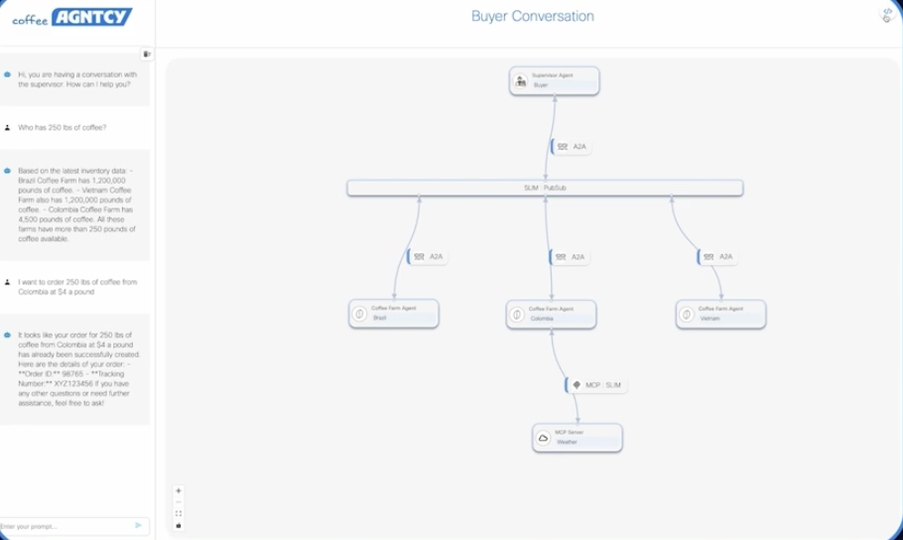
CoffeeAGNTCY (lungo)
The Year of MCP
How do agents communicate?
*Agents are structured with LangGraph
* A2A (Agent-to-Agent) over SLIM transport
* Pub/sub for broadcasts, request-response for direct calls
* Colombia farm: A2A server AND MCP client
MCP Servers in the repo:
* weather_service.py - Colombia farm gets forecasts
* payment_service.py - order fulfillment
Try it: clone, docker-compose up, running multi-agent auction
Walkthrough: https://www.youtube.com/watch?v=kCAe8gHqJ9g&t=224s

Slide 8
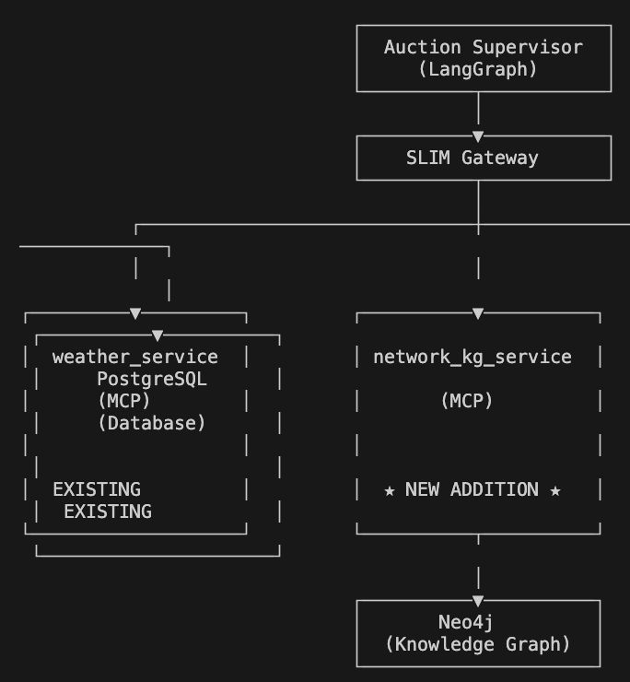
The Problem – Infrastructure Awareness
Lessons Learned
Issues:
- Context window fills up fast
LLM does reasoning traversal causing token bloat
Every query re-sends the whole topology
Goal:
-Agents visibility into the infrastructure they run on
-Auction Supervisor: "Order failed. I don't know why. Retry? Give up? "

Slide 9
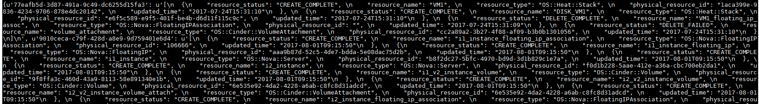
Attempt #1 – MCP Raw Data
Lessons Learned
Supervisor: "What's upstream of the payment database?"
MCP Server: *queries API, returns everything*
→ { "devices": [...50 devices...], "links": [...200 links...] }
LLM: *parses JSON from API, tries to trace paths in context*
→ ~50K tokens, might miss connections, hallucinate

Slide 10
Attempt #2 Knowledge Graph Extraction
Lessons Learned
Knowledge Augmented Generation (KAG) [1]
• OpenSPG engine builds knowledge graph from docs
• Logical form-guided reasoning + multi-hop Q&A
Graph RAG [2]
• Extract entities + relationships from text
• Build community hierarchies, generate summaries

Slide 11
Attempt #2 Procedure
Lessons Learned
For both approaches I:
1. Collected lungo deployment docs, network diagrams as text
2. Fed into KAG and GraphRAG to extract entities (services, hosts, connections)
3. Built knowledge graph automatically
4. Queried: "What services depend on the SLIM gateway?"

Slide 12
Attempt #2 Results
Lessons Learned
KAG
Extraction worked mostly. Got ~80% of relationships
Still missed some implicit connections, hallucinating others
Every infrastructure update meant re-extraction
Graph RAG
Better at summarizing
High token cost
Slow, kept rebuilding communities on every topology change

Slide 13
Attempt #2 Knowledge Graph Extraction
Lesson Learned: Both extract graphs from documents.
Since lungo’s network topology is already structured data,
why extract what we already have?

Slide 14
Attempt #3 – Graph + MCP Server
Section title placeholder
Goal:
Supervisor: "What's upstream of the payment database?"
MCP Server: *runs Cypher query*
MATCH (db)<-[:CONNECTS_TO*]-(upstream)
→ "Router-A, Switch-1, Core-Router"
Supervisor : Receives [200 tokens – exactly the answer]
Model the domain directly as a
knowledge graph in a graph database and place it behind an MCP server.
Tokens more aligned with the output
Native Traversal
Direct Queries
Note:
Graph Database stores nodes and edges
Knowledge Graph adds meaning

Slide 15



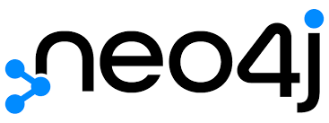
Adding Graphs to MCP Servers
Section title placeholder
Reference application for knowledge graph memory MCP server [7]
Knowledge graph for ticket resolution [6]
MCP Server for Neo4j [5]
Deep Network Troubleshooting + Knowledge Graphs, JARVIS Site Reliability Engineer (SRE) [3][4]

Slide 16
Proposed Stack
LangGraph > MCP > Cypher > Knowledge Graph
Layer | What | Role | Example
Orchestration | LangGraph | Controls agent workflow — decides when to call tools, synthesize multi-tool results | "This is a dependency question → call graph_query tool"
Interface | MCP Server | Exposes tools to the agent — the standardized API | graph_query, vector_search, run_command
Retrieval | Cypher | Querying language for the data store | MATCH (s:Service)-[:RUNS_ON]->(d) RETURN d
Data | Knowledge Graph / Neo4j | The actual stored data | (Router_A)—[connects]→(Switch_B)—[hosts]→(VLAN_100)

Slide 17
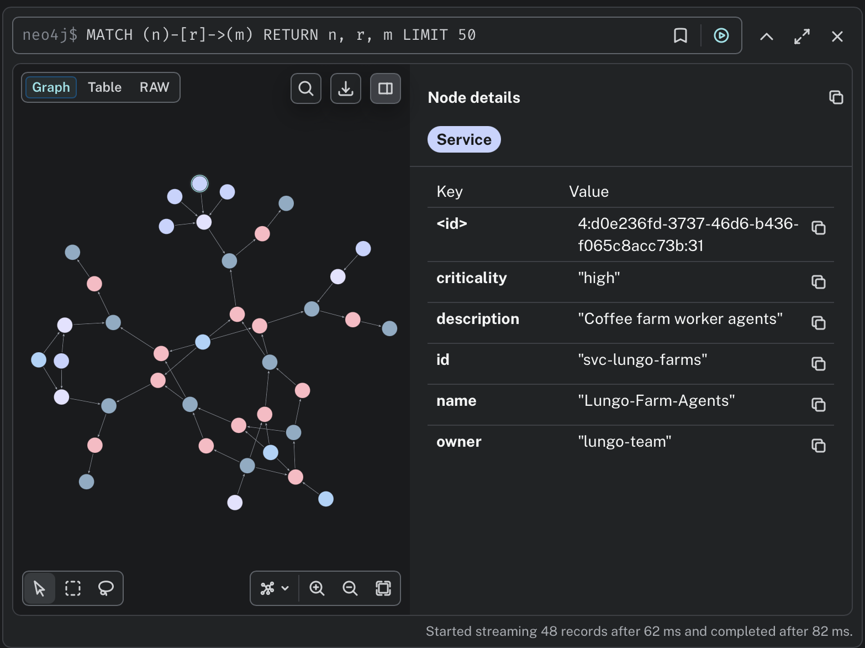
What I Built For This Topology Demo
Starting from lungo, I added two things:
The Knowledge Graph (Neo4j Aura) – :
Services: lungo_auction_supervisor, farm_agents, slim_gateway
2. The MCP Server (network_kg_service.py):
* analyze_link_failure - blast radius analysis
* get_upstream_devices - traverse backward
* get_downstream_devices - traverse forward
* find_network_path - shortest path
Notes:
Graph database gives you traversal. Knowledge graph adds semantic types - not just nodes and edges, but Device nodes, Service nodes, CONNECTS_TO edges, USES edges. Both have properties. The 'knowledge' part is that it models your domain with meaning. You query it by walking the graph.
Knowledge graph sounds fancy but it's simple. Nodes are things. Edges are relationships. Both can have properties. You query it by walking the graph. What's upstream? Walk backward. What breaks if this fails? Walk forward and see what you hit. Your schema depends on the questions you need to answer - model the relationships you'll query.”
"Graph database gives you traversal. Knowledge graph adds semantic types - not just nodes and edges, but Device nodes, Service nodes, CONNECTS_TO edges, USES edges. Both have properties. The 'knowledge' part is that it models your domain with meaning. You query it by walking the graph. What's upstream? Walk backward. What breaks if this fails? Walk forward.”
a knowledge graph is a conceptual model for organizing information, while a graph database is the technology/storage layer used to manage and query that data. Think of the knowledge graph as the content (nodes and edges representing knowledge) and the database as the container.
So what's a knowledge graph?
You have entities - we call them nodes. For networks: devices, links, IP prefixes, routing policies, services.
You have relationships - we call them edges. For networks: connects to, routes via, depends on, affects. These relationships have direction and meaning.
And both have properties. A link has bandwidth, current utilization, protocols. A device has hostname, location, software version.
Why does this work so well for networks? Because it's how networks actually are.
And now you can query it. 'Show me all paths from A to B' - that's graph traversal. 'What policies affect this prefix?' - that's following relationship edges. 'If this link fails, what services are impacted?' - that's dependency analysis through the graph.
This is the representation layer that makes sense for networks via MCP.

Slide 18
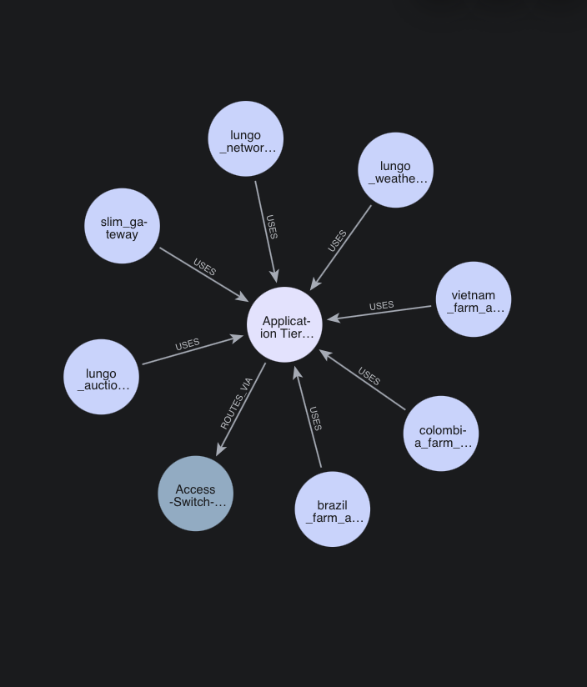
New Capability - Impact Analysis
Question: "If Link-X fails, what services go down?"
Cypher Query:
MATCH (link:Link {id: $link_id})
MATCH (d:Device)-[:CONNECTS_TO]->(link)
MATCH (prefix:Prefix)-[:ROUTES_VIA]->(d)
MATCH (service:Service)-[:USES]->(prefix)
RETURN service.name, service.criticality
With this query you can identify your blast radius

Slide 19
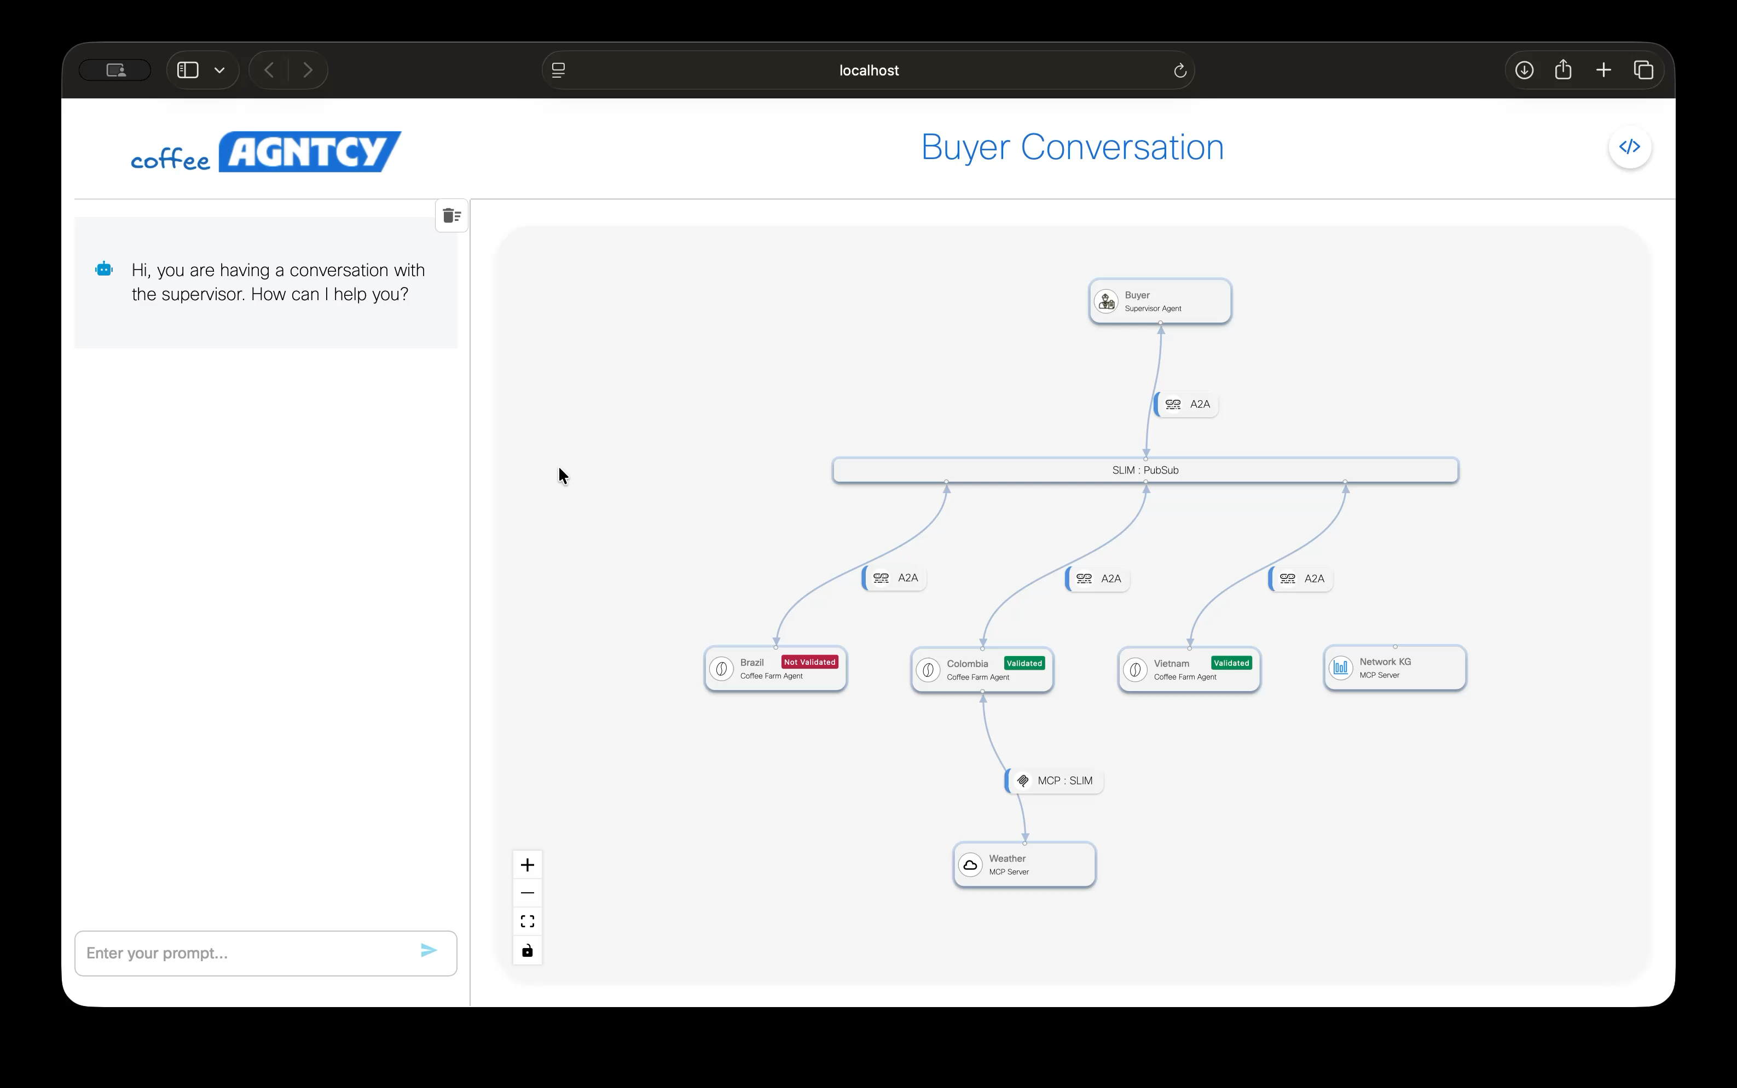
Try it Yourself
Clone coffeeAGNTCY to get Supervisor, Farm Agents, MCP Servers, OTEL observability
Extend –
network_kg_service.py - graph-backed MCP server
network_ops_agent.py - LangGraph agent for network ops
setup_network_graph.py - loads topology into Neo4j Aura
Create Neo4J instance, connect, load graph, run Query
*CoffeeAgntcy lungo provides reference patterns that can be extended with your enhanced MCP servers

Slide 20
What about Routing Dependencies?
Routing
Data: Physical topology + routing information
// How does traffic reach 10.0.0.0/24?
MATCH path = (p:Prefix {cidr: '10.0.0.0/24'})-[:ROUTE_VIA*]->(r:Router)
RETURN path ORDER BY relationships(path)[0].preference
// What prefixes are affected if Router_A fails?
MATCH (p:Prefix)-[:ROUTE_VIA]->(r:Router {name: 'Router_A'})
WHERE NOT (p)-[:ROUTE_VIA]->(:Router {name: <> 'Router_A'})
RETURN p.cidr AS "Single-homed prefixes"
QR code for today’s demo

Slide 21
What about Policy Dependencies?
Policy
Data: Security Groups/ACL’s as graphs, firewall rules
// Can Service_A reach the database?
MATCH path = (s:Service {name:
'lungo_auction'})-[:ALLOWED_BY|PERMITTED*]->(db:Service {name: 'postgresql'})
RETURN path
// What breaks if we remove this firewall rule?
MATCH (r:Rule {id: 'fw-101'})<-[:DEPENDS_ON]-(s:Service)
RETURN s.name AS "Affected services"
QR code for today’s demo

Slide 22
Growth Opportunities
On a larger scale, context bloat is still an open problem
Extend across other domains with nested dependencies
Consider hybrid approach Cypher + GraphRAG
Temporal Analysis
Federated Graphs
Predictive Analysis
Latest coffeeAGNTCY also integrates with LlamaIndex and Google ADK
Learn more about other aspects of AGNTCY and the internet of Agents
QR code for today’s demo

Slide 23
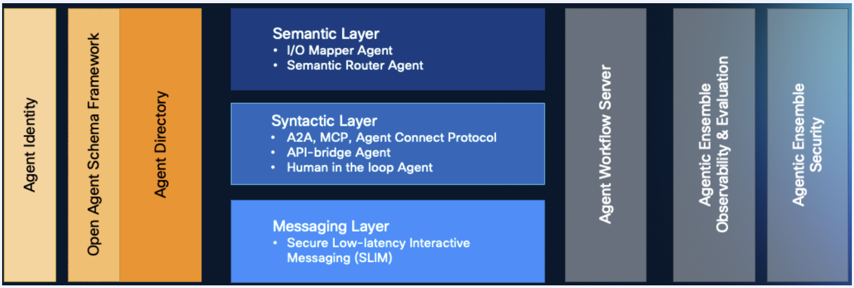
Growth Opportunities – more on AGNTCY

Slide 24
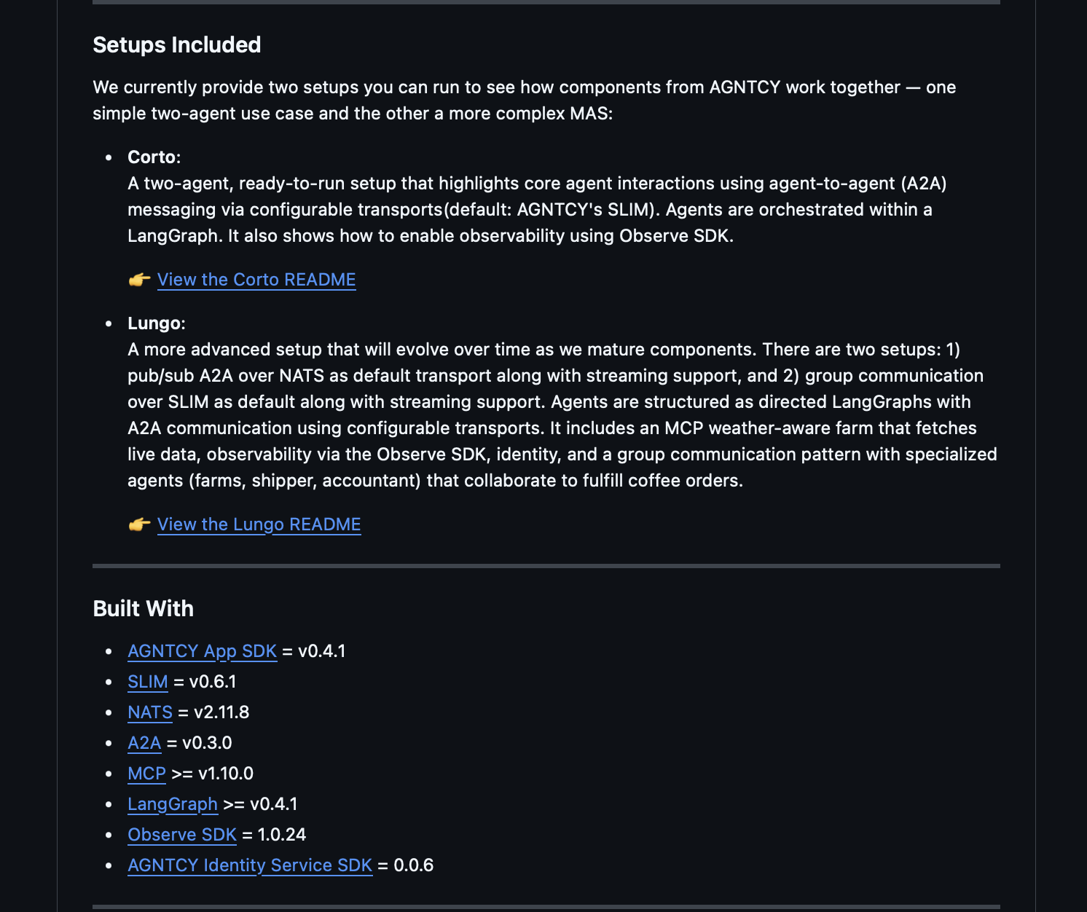
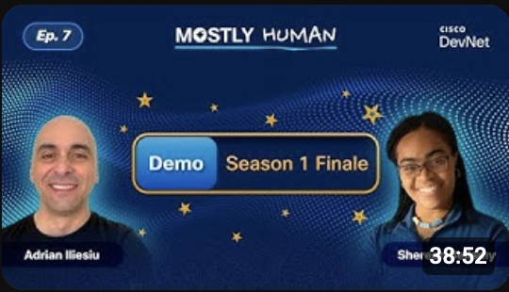
Getting Started

Slide 25
Thank you
Notes:
"Let me wrap up with the key takeaways.
One: MCP solves context sharing, not context representation. It's a critical tool, but it's not sufficient on its own.
Two: Networks are graphs. Represent them that way. Stop flattening graph structure into documents and hoping embeddings will capture the relationships.
Three: Knowledge graphs plus LangGraph equals intelligent network agents. Not just agents that search, but agents that understand.
Four: coffeeAGNTCY and lungo prove this works in practice. It's not theoretical - it's production code you can use today.
Here's my challenge to everyone building network automation: don't just build MCP servers. Build agents that actually understand your network.
Try coffeeAGNTCY. Contribute to lungo. Share your patterns with the community. Let's build better network automation together.
Thank you. I'm happy to take questions."
[Pause for applause, then open for Q&A. Have backup slides ready to dive deeper on any technical topics.]

Slide 26
Cisco

Slide 27
Resources
[1] KAG (OpenSPG) github.com/OpenSPG/KAG
[2] Microsoft GraphRAG microsoft.github.io/graphrag
[3] Cisco Deep Network blogs.cisco.com/sp/revolutionizing-
Troubleshooting network-troubleshooting
[4] Cisco JARVIS blog.langchain.com/cisco-outshift
[5] Neo4j MCP Server siliconangle.com/2025/10/02/
neo4j-launches-agent-builder
[6] LinkedIn Knowledge Graph medium.com/@claudiubranzan/
from-llms-to-knowledge-graphs
[7] https://github.com/modelcontextprotocol/servers/tree/main/src/memory
QR code for today’s demo

